Slide 1
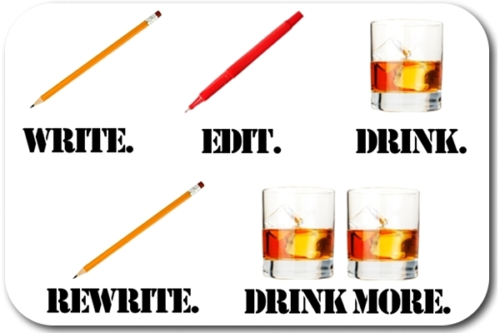

The Writing Process?
Technical Communication for Engineers
to

Slide 2
The Writing Process: 3 Steps
“Writing is a process, not an event.”
1. Pre-Writing 40%
2. Writing 30%
3. Re-Writing 30%
Technical Communication for Engineers
Notes:
Illustrates the amount of time that should be spent in each of the phases of writing. Many students sit down to write a document, give it a brief review (if at all), run the spell check (if at all), and turn in a finished product. The writing process consists of three distinct steps.

Slide 3

Step 1. Before You Write: PAGE
Purpose
Audience
GenrE
Technical Communication for Engineers
Notes:
The three most important things a writer can do before actually writing any words are think clearly about audience, purpose, and genre.

Slide 4
What is Purpose?
Engineers write to:
Inform
Update
Instruct/educate
Persuade/recommend
Technical Communication for Engineers
to
Notes:
Engineers need to be very clear about the purpose of the document and that purpose statement should be included in all documents.

Slide 5
What is Purpose?
Your purpose should be explicitly stated in all of your technical documents in the Abstract.
“The purpose of this document is to……”
“This document will…….”
Technical Communication for Engineers
to
Notes:
Engineers need to be very clear about the purpose of the document and that purpose statement should be included in all documents.

Slide 6
Your Responsibility to Your Audience
To frame technical documents so they have meaning to all who read them—no matter their level of understanding.
Technical Communication for Engineers
to
Notes:
Tell story of me being a science major and professor telling me I write science better than I do science. Why? Because I could communicate it in a way that was understandable. That’s what all of these individual shave in common: These individuals could all reduce complex cosmic or scientific concepts into ideas the average person could understand.

Slide 7


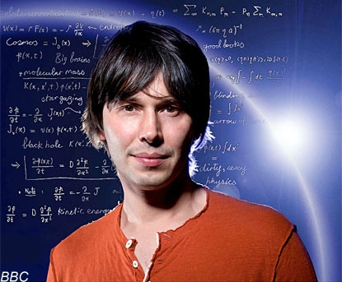
Your Responsibility to Your Audience
In other words: turn your engineering into English
Bill Nye, The Science Guy
Brian Cox, Physicist, CERN
Technical Communication for Engineers
to
Notes:
Tell story of me being a science major and professor telling me I write science better than I do science. Why? Because I could communicate it in a way that was understandable. That’s what all of these individual shave in common: These individuals could all reduce complex cosmic or scientific concepts into ideas the average person could understand.

Slide 8
Your Responsibility to Your Audience:
Turn Your Engineering into English
The Second Law of Thermodynamics: Entropy
A thermodynamic quantity representing the unavailability of a system’s thermal energy for conversion into mechanical work, often interpreted as the degree of disorder or randomness in
the system.
2. Lack of order or predictability; gradual
decline into disorder.
Brian Cox, CERN
Technical Communication for Engineers
to
Notes:
Tell story of me being a science major and professor telling me I write science better than I do science. Why? Because I could communicate it in a way that was understandable. That’s what all of these individual shave in common: These individuals could all reduce complex cosmic or scientific concepts into ideas the average person could understand.

Slide 9
Who is my Audience?
How well do I know my reader(s)?
How much does my reader(s) know about the subject?
How much does my reader(s) need to know about the subject?
What characteristics do my readers have (age, gender, ethnicity)?
Who is my primary audience? Secondary audience(s)?
What are my reader’s needs and expectations?
Why do they care?
What will my reader do with the information?
How will my reader best receive or take in information?
Technical Communication for Engineers
to
Notes:
Perhaps more than anything, audience dictates how documents are written. Think carefully about your audience and answer these questions.

Slide 10
The High-Tech Audience: You
Experts in your field (other engineers) who:
have similar experience, education, and levels of understanding.
require minimal detail regarding technical processes or theories.
need little background information.
are familiar with jargon, acronyms, and abbreviations.
understand calculations, results, observations, facts, and illustrations.
Sample audience type: Other engineers, managers with technical backgrounds
Technical Communication for Engineers
to
Notes:
Easiest audience type to write to because they are people like you. SME = subject matter experts.

Slide 11
The Semi-Tech Audience
Individuals in your organization who build, test, or sell what you develop and who:
are familiar with the subject but not at an expert level.
possess some level of understanding but of a more practical nature.
may need background information.
may need processes, calculations, illustrations explained.
are familiar with jargon, acronyms, and abbreviations.
Sample Audience Type: Technicians, Technical Sales Representatives
Technical Communication for Engineers
to
Notes:
Example would be information written for a technician; they may possess some level of understanding but it isn’t to the degree you possess. Be careful not to assume it is.

Slide 12
The Low-Tech Audience
Co-workers in other departments and colleagues in other companies who:
are familiar with the subject matter, but it’s not within their primary area of expertise.
prefer abbreviations, jargon, technical terms, concepts, and acronyms be defined.
need simpler illustrations.
need background information.
may have unrealistic expectations or think they know more than they know.
Sample audience type: Co-workers in the marketing department
Technical Communication for Engineers
to
Notes:
Student doing an internship was in a meeting where the client wanted them to “create a box invisibly larger than it actually is.”
Can be a difficult audience to write for, particularly because “they know just enough to be dangerous.” The YouTube hyperlinked in this last bullet point is an excellent parody of audience expectations.

Slide 13
The Managerial Audience
Managers and executives who:
may or may not be experts in your field.
make decisions to approve projects, resources, budgets, and schedules.
need background information in order to make decisions.
may need unfamiliar terms, processes, or definitions defined.
are familiar with jargon, abbreviations, acronyms.
Sample audience type: CEO, CFO
Technical Communication for Engineers
to
Notes:
Their primary interest is the bottom line: how much is it going to cost, what is the resource allocation going to be, what is the potential revenue. They need background information but their interest is not from a technical standpoint, but from a managerial/financial standpoint. It is important to remember that some of your managers may have engineering backgrounds and once may have been part of a high-tech audience, but some may not have that level of knowledge.

Slide 14
The Multi-Tech Audience
Can include a combination of high-tech, low-tech, and managerial audiences and who:
may or may not be familiar with the subject matter.
need jargon, acronyms, processes, and terms defined.
need background information.
Technical Communication for Engineers
to
Notes:
Difficult to write for as you have to take into account all audience needs. The multi-tech audience may be reading for very different purposes. For example, managers may read the sections of a proposal that are relevant to them; engineers may read the sections of a proposal relevant to them. They read different sections for different reasons.

Slide 15
The No-Tech (Lay) Audience**
Who are they? Customers or clients who neither work for your company nor have any knowledge about your field and who:
are unfamiliar with your subject matter and terminology.
need the topic explained through careful word usage, depth of detail, and simple graphics.
don’t understand terminology, jargon, abbreviations, or acronyms—define thoroughly or don’t use at all.
need background information.
may be educated or uneducated
**The average adult in the US reads on a 5th grade level.
Technical Communication for Engineers
to
Notes:
Difficult to write for as you have to take into account all audience needs. The multi-tech audience may be reading for very different purposes. For example, managers may read the sections of a proposal that are relevant to them; engineers may read the sections of a proposal relevant to them. They read different sections for different reasons.

Slide 16
Examples From Engineering Texts
“Infant mortality includes two major elements, DOAs and DOFs. DOAs are devices that fail when initially tested after shipment or incorporation in the next assembly level. For example, incoming inspection failures, first circuit pack failures, and equipment turn-on failures after installations are all DOAs. The length of the infant mortality period cannot be exactly defined, but generally it has its greatest impact in the first year of device use.”
C.M. Bailey, “Semiconductor Reliability,” Electronics Engineer’s Handbook
Technical Communication for Engineers
to
Notes:
This is an example of the need to think carefully about your audience and customize the message. An expert in the field will have a very different definition of “infant mortality” and “dead-on-arrivals” than will a lay audience.

Slide 17
Examples From Engineering Texts
A master-to-slave exchange…occurs only when requested by the master. The slave waits for the master to assert MASTER RDY before placing data on the bus and asserting SLAVE RDY. After the master reads the data, it drops MASTER RDY, confirming the receipt. The slave acknowledges by lowering SLAVE RDY. After transferring the specified number of bytes, the slave again looks for commands from the master.
D.S. Stout, Microprocessor Applications, 17-9, 17-10
Technical Communication for Engineers
to

Slide 18
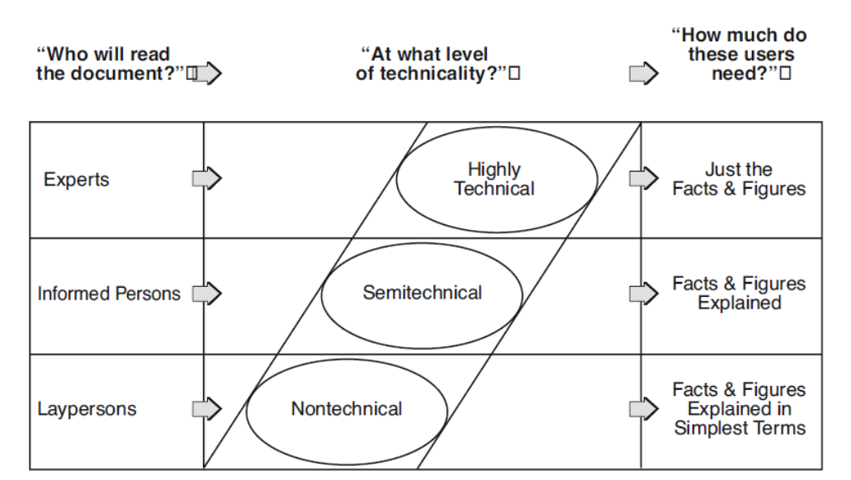
Audience Adaptation
Technical Communication for Engineers
to
Notes:
Often you are writing to different audiences within the same document (example: proposals). Some parts of the document are written for a specific audience, while other elements are written for another audience type. Often you may be taking a document written for a high-tech or low-tech audience and adapting the message for a lay audience. Show the first few minutes of the TedTalk hyperlinked above. Very clearly uses analogies to explain highly technical terms (I would stop the video where the speaker introduces the periodic table).

Slide 19
Audience Adaptation
Add information readers need and omit information they don’t need
Add background information
Use appropriate language
Adapt the level of technicality
Add examples and analogies to help readers understand
Work on sentence clarity
Write logically
Use different or simpler graphics
Break text up into meaningful, usable chunks
Use headings and lists
Use the appropriate genre
https://www.prismnet.com/~hcexres/textbook/aud.html
Technical Communication for Engineers
to
Notes:
Often you are writing to different audiences within the same document (example: proposals). Some parts of the document are written for a specific audience, while other elements are written for another audience type. Often you may be taking a document written for a high-tech or low-tech audience and adapting the message for a lay audience. Show the first few minutes of the TedTalk hyperlinked above. Very clearly uses analogies to explain highly technical terms (I would stop the video where the speaker introduces the periodic table).

Slide 20



What is Genre?
Technical Communication for Engineers
to
Notes:
Genres are “categories” of things (like movies).

Slide 21
What is Genre in Technical Writing?
Genre: A predictable pattern of presenting information that serves both form and function.
Form: The visual design of your document (title page, table of contents, etc.).
Function: The set of topics the reader expects to find (background, method of work, management plan).
Technical Communication for Engineers
to
Notes:
A genre in technical writing is a category of writing that has a particular form and content. Emphasize that genre consists of both form (the visual design and format) as well as function (what the reader expects to find in the document).

Slide 22
Common Engineering Genres
Studies
Efficiency
Market
Bioethical
Environmental Impact
Research
Development
Analytical
Guides
Procedures
Tutorials
Training Aids
Safety Instructions
Supplier Review
Publications
Articles
Textbooks
Newsletters
News Releases
Literature Reviews
Marketing Brochures
Catalogs
Business
Internal Memos
Letters
Email
Technical Reports
Evaluation
Test Methods
Feasibility
Troubleshooting
Specification
White Papers
Standard Reports
Weekly/Annual
Progress
Lab
Inspection
Implementation
Manuals
Users’ Handbook
Maintenance
Repair
Policy
Product Support
Operations
Instructions
Corporate
Proposals
Executive Summaries
Abstracts
Contracts
Patents
Policy Statements
Statements of Work
Interoffice
Users’ Handbook
Maintenance
Repair
Policy
Product Support
Operations
Instructions
Special Reports
Formal
Recommendation
Trip
Investigation
Site
Incident
Technical Communication for Engineers
Notes:
There are many different kinds of genres in engineering writing. Here are some of the common ones engineers can expect to encounter in their careers.

Slide 23
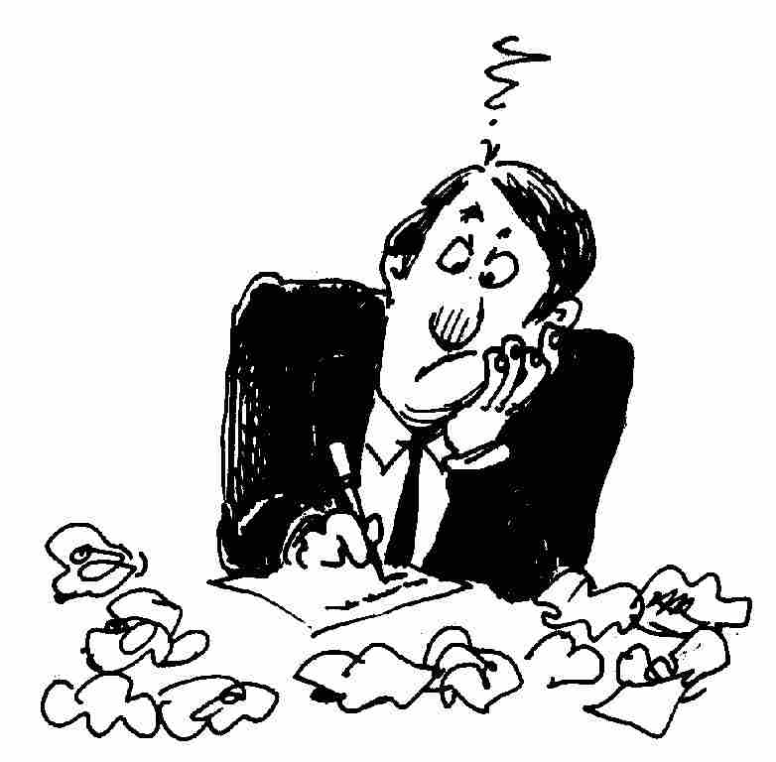
Step 2. While You Write: Drafting
Get your thoughts down on paper—free write
Leave yourself plenty of time
It doesn’t have to be good
Break the writing up into “chunks”
Put your document away and come back later
Do not edit/proofread as you write
Write the sections you know most about first
Your first is the worst
Technical Communication for Engineers
to
Notes:
Emphasize that students don’t have to write in a linear fashion from beginning to end. It’s OK in this stage to start writing wherever they choose. The biggest problem with the drafting stage is that this is where most writers tend to stop. A drafted document is not meant to be a final document. This is where the real problems occur with clarity, conciseness, understanding.

Slide 24
Step 3. After You Write: Perfecting
Complex technical information and the use of tech writing standards make re-writing critical.
Edit carefully (more than just grammar)
Look for inconsistencies in formatting (font sizes, headings, page numbers)
Check equations, formulas, tables, figures
Correct grammar, punctuation, spelling, and usage errors
Ask someone else to edit your document for content and comprehension and to proofread for language mechanics.
Technical Communication for Engineers
to
Notes:
Re-writing is where you ensure your documents are clear, concise, correct, complete, concrete, considerate and credible. Ask how many students spend 30% of their time re-writing a document. Chances are very few do.

Slide 25
The Differences Between Editing
and Proofreading
Editing: Focuses on content (meaning, transitions, clarity, correctness, word choice/language, organization, structure).
Proofreading: A part of the editing process that focuses on grammar, spelling, and language mechanics.
Technical Communication for Engineers
to
Notes:
Proofreading and editing are two different activities. Proofreading focuses primarily on language mechanics. Why is it so hard to identify all of the f’s (7 of them) in the above sentence? Two reasons: technical writers tend to become very familiar with the content and that familiarity often makes it difficult to find errors and some of the fs in the sentence have a “v” sound.

Slide 26

But, Does it Really Matter?
How a Typo May Have Turned a Drum of Radioactive Waste Into a Bomb
The Waste Isolation Pilot Plant (WIPP) in Carlsbad, New Mexico, is now shut down, awaiting a $500 million recovery plan that could take years. WIPP is made up of salt caverns that are supposed to safely entomb barrels of radioactive waste. The barrels are often packed with kitty litter to absorb extra liquids before being sealed.
A typo was made in the policy manual that indicated use of a wheat-based (organic) kitty litter instead of a clay-based (inorganic) kitty litter and had gone unnoticed. Thanks to that typo, the drum ultimately contained the ingredients of a bomb, which blasted open on February 14, 2014. No injuries were sustained, but 20 workers were exposed to levels of radiation.
Technical Communication for Engineers

Slide 27
Editing Tips
Ask yourself, “who, what, when, where, why
Do the math—check all equations and calculations
Check that figure and table numbers match the references in the text
Check the structure (abstract, body, conclusion)
Make sure content is arranged logically
Have someone else read the document
Technical Communication for Engineers
to

Slide 28
Proofreading Tips
Leave yourself time
Read the document backwards
Read the document aloud
Spell check the document
Examine each word individually (especially little words)
Circle every punctuation mark
Look for errors you frequently make
Print it out
Look for one problem at a time
Have someone else read the document
Technical Communication for Engineers
to

Slide 29
Why is it so Hard to Find Errors?
I cdnuolt blveiee that I cluod aulaclty uesdnatnrd what I was rdanieg. The phaonmneal pweor of the hmuan
mnid, aoccdrnig to a rscheearch at Cmabrigde
Uinervtisy, it dseno't mtaetr in what oerdr the ltteres in a word are, the olny iproamtnt tihng is that the frsit and last ltteer be in the rghit pclae. The rset can be a taotl mses and you can still raed it whotuit a pboerlm. This is
bcuseae the huamn mnid deos not raed ervey lteter by istlef, but the word as a wlohe. Azanmig huh? Yaeh and
I awlyas tghuhot slpeling was ipmorantt!
Technical Communication for Engineers
to
Notes:
How many of you can read this? Your mind doesn’t look at individual letters, but words as a whole. Another reason why it’s difficult to find errors.,

Slide 30
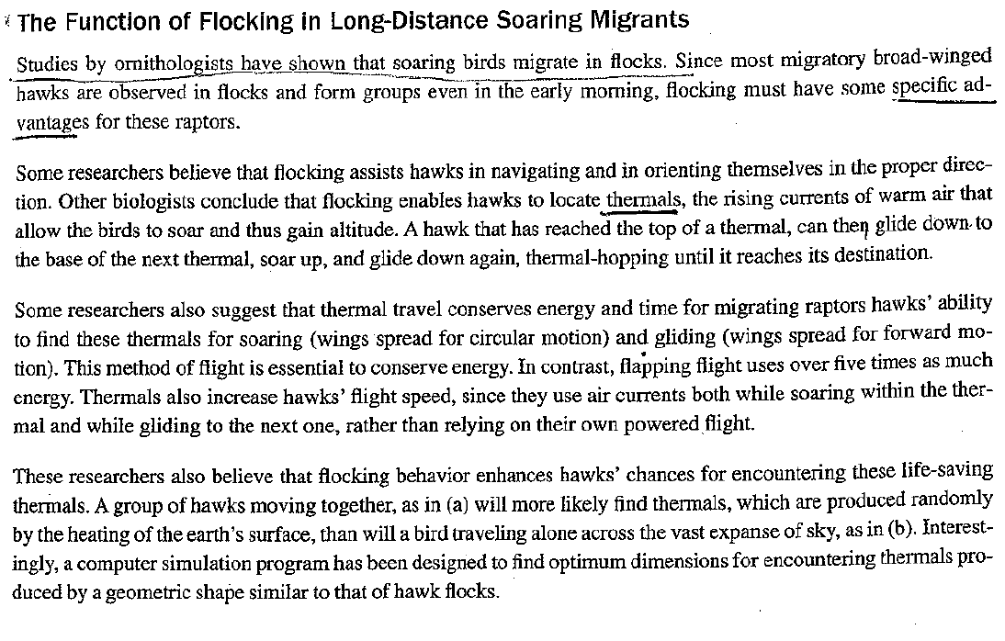
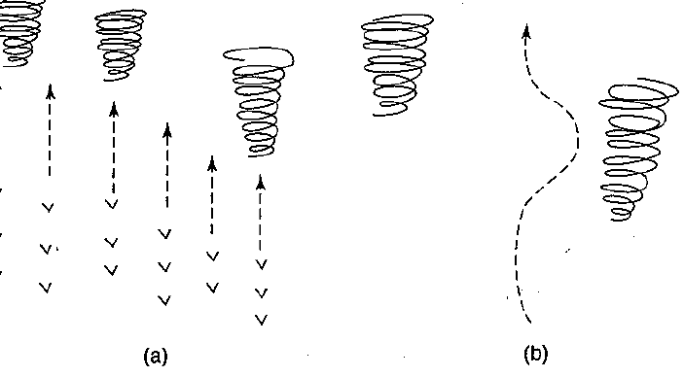
Audience Adaptation Example
Written for college students in intro science course
to

